Slide 1

Toddler Autism Diagnosis Data
Authors:
Joshua Summers
Cindy Chitsuwa
Jack Mcdonald

Slide 2
What is Autism
Autism is a developmental condition that affects:
Communication
Behavior
Social interaction
Focused on toddlers because:
Early screening can lead to early detection
better medical outcomes
The dataset uses simple behavioral questions
Connects data science with a meaningful, real-world issue.

Slide 3
Narrative
Our group was interested in Autism diagnosis in Toddlers
Autism is a growing global health issue, and early screening can change lives.
We wanted to explore: What factors are most important in determining an autism diagnosis?

Slide 4
Dataset Overview
1054 toddler screening records from the ASDTests app
Features include behavior questions, gender, family history, and more
Q-Chat-10 scores are used to detect ASD traits
Notes:
This dataset came from a screening app and includes over a thousand responses.
It focuses on toddler behavior using 10 specific questions.\
We also looked at things like gender and family background.

Slide 5

Methodologies
We analyzed the Principal Components (to see correlation)
Unique visualizations
Used PCs for guidance on features to use

Slide 6
Correlation Analysis
Principal Component Analysis modeled
Correlations observed:
PC1 suggests Diagnosis Correlation
PC2 suggests Non-verbal Behavior
PC3 suggests verbal Behavior

Slide 7
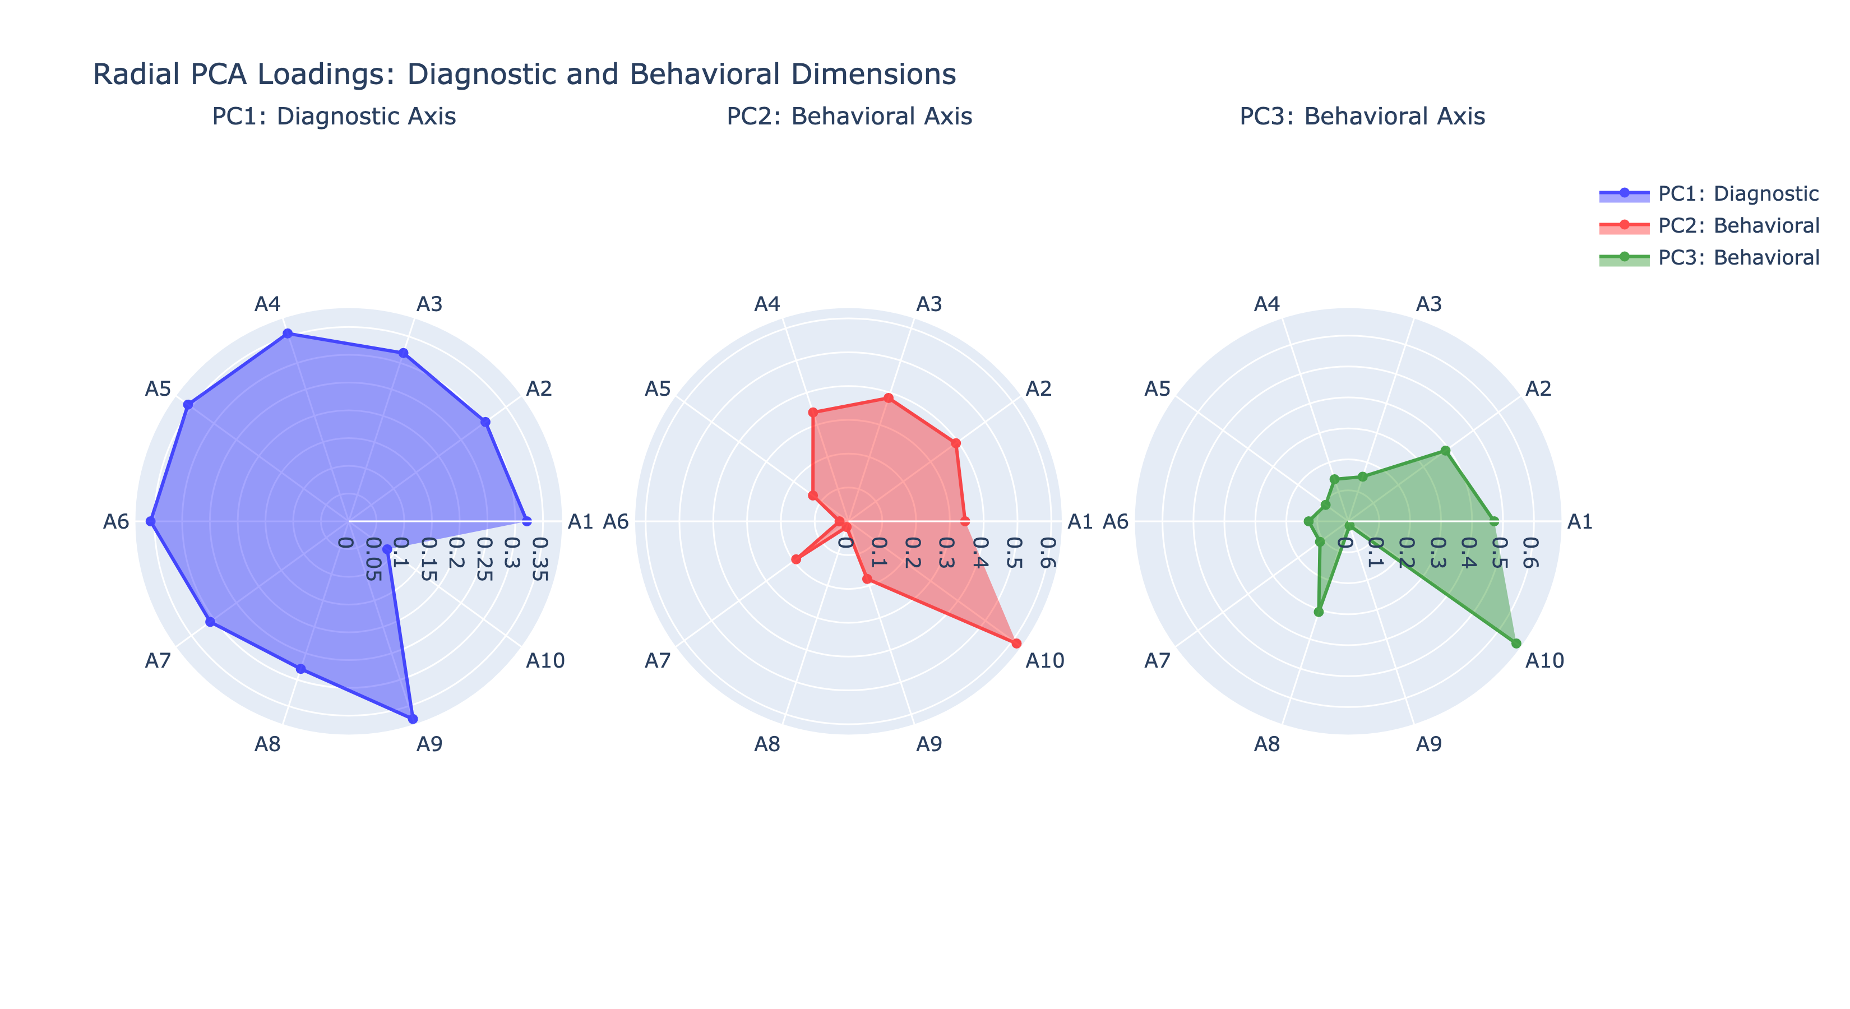
PCA Analysis
Notes:
This was a good way to get some insight into what the Q-Chat questions meant to the overall Autism Diagnosis and how they related to the other features in this data set. From this Analysis, it was clear that PC1 was related to Diagnostic features, and this was the dimension reflected in this primary component. PC2 and PC3 showed behavioral relationships between the questions, with PC2 reflecting non-verbal communication and PC3 reflecting verbal communication

Slide 8
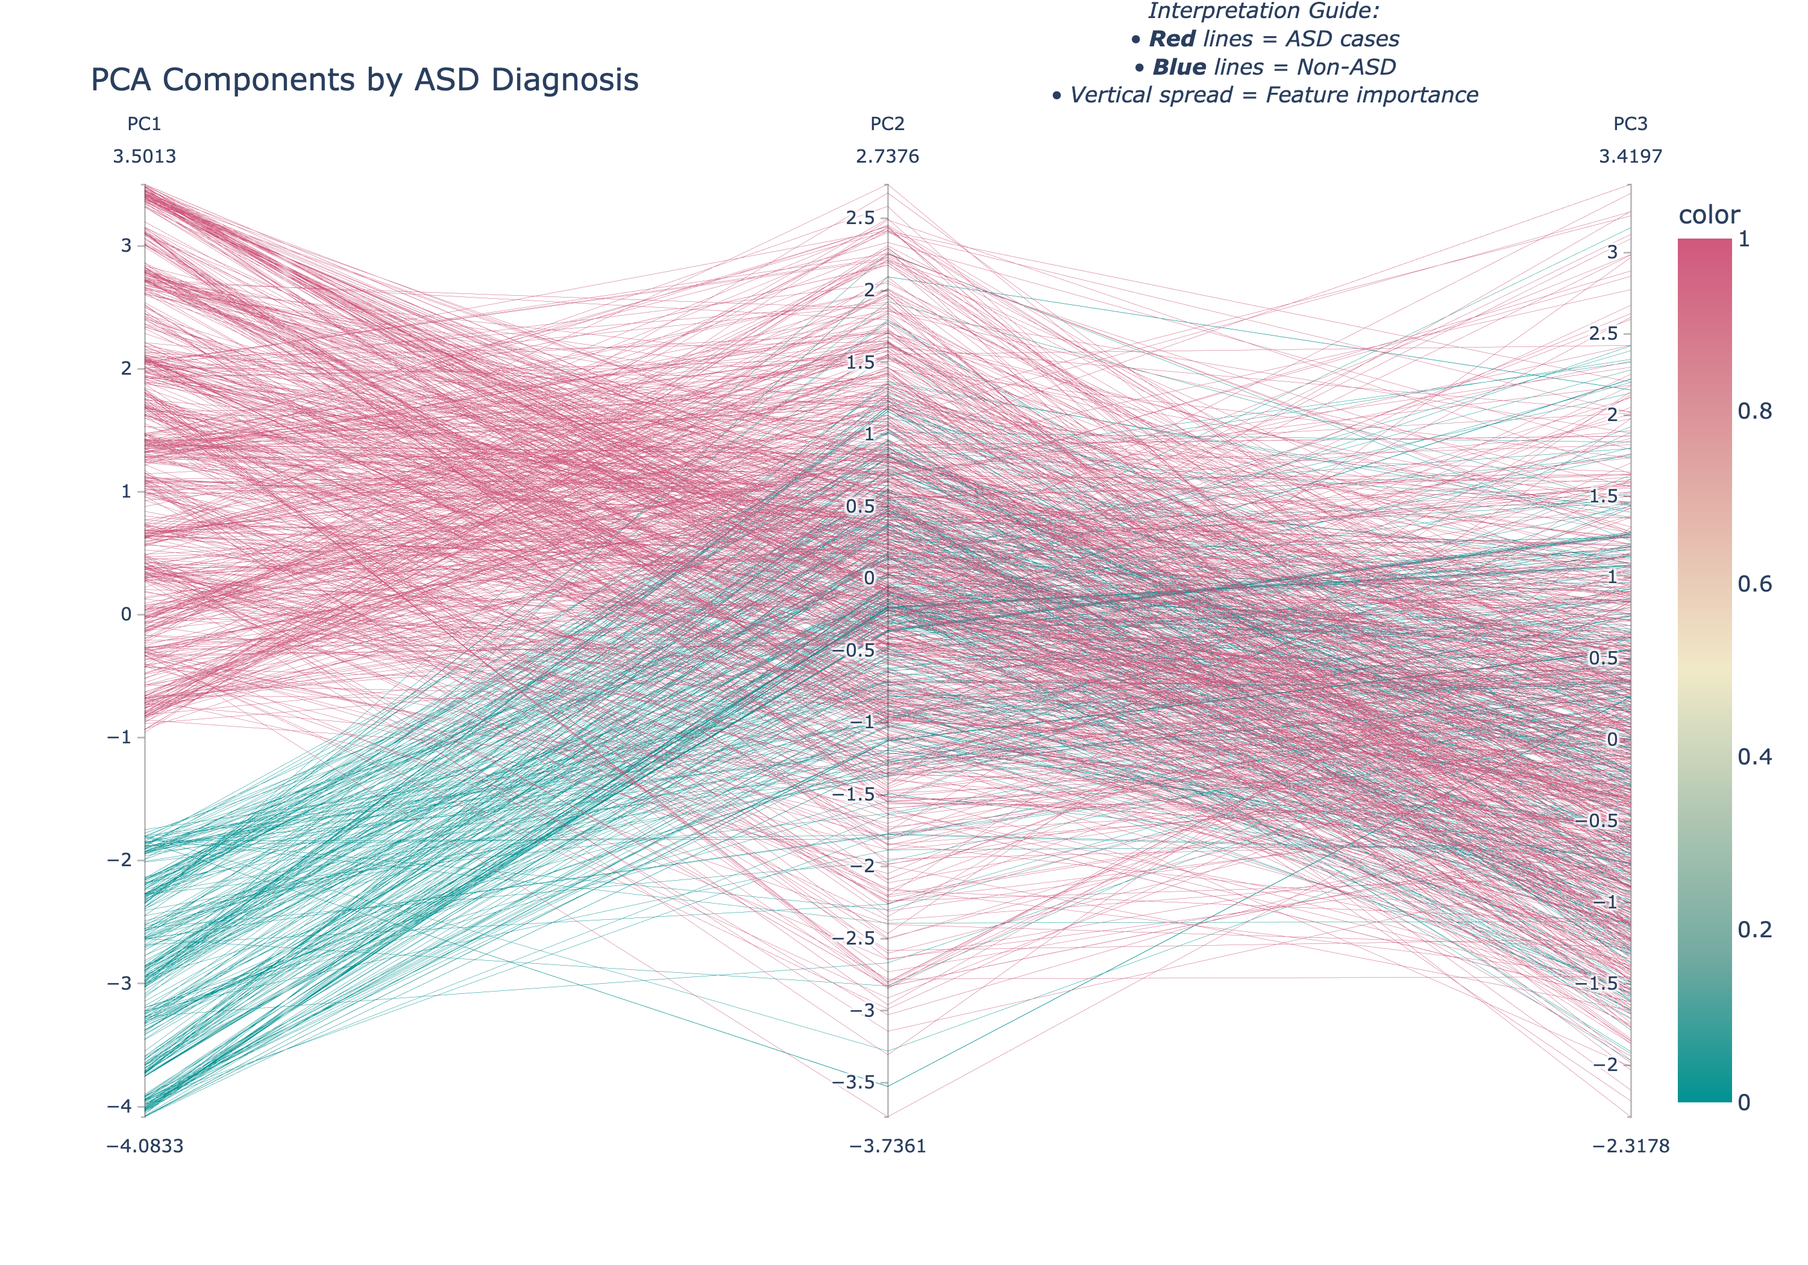
Clustering and Inference
PC1 Clusters on Autism Traits
PC2 Clusters only on No Autism
PC3 has no clustering

Slide 9
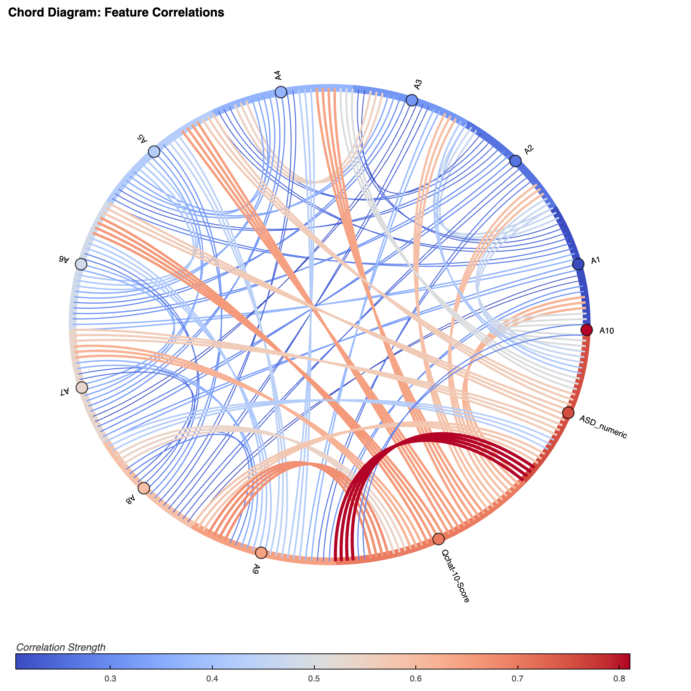
Chord Diagram
PCA nodes and edges as a graph
Show correlation intensity or strength
Easily see connections between Q-chat questions

Slide 10
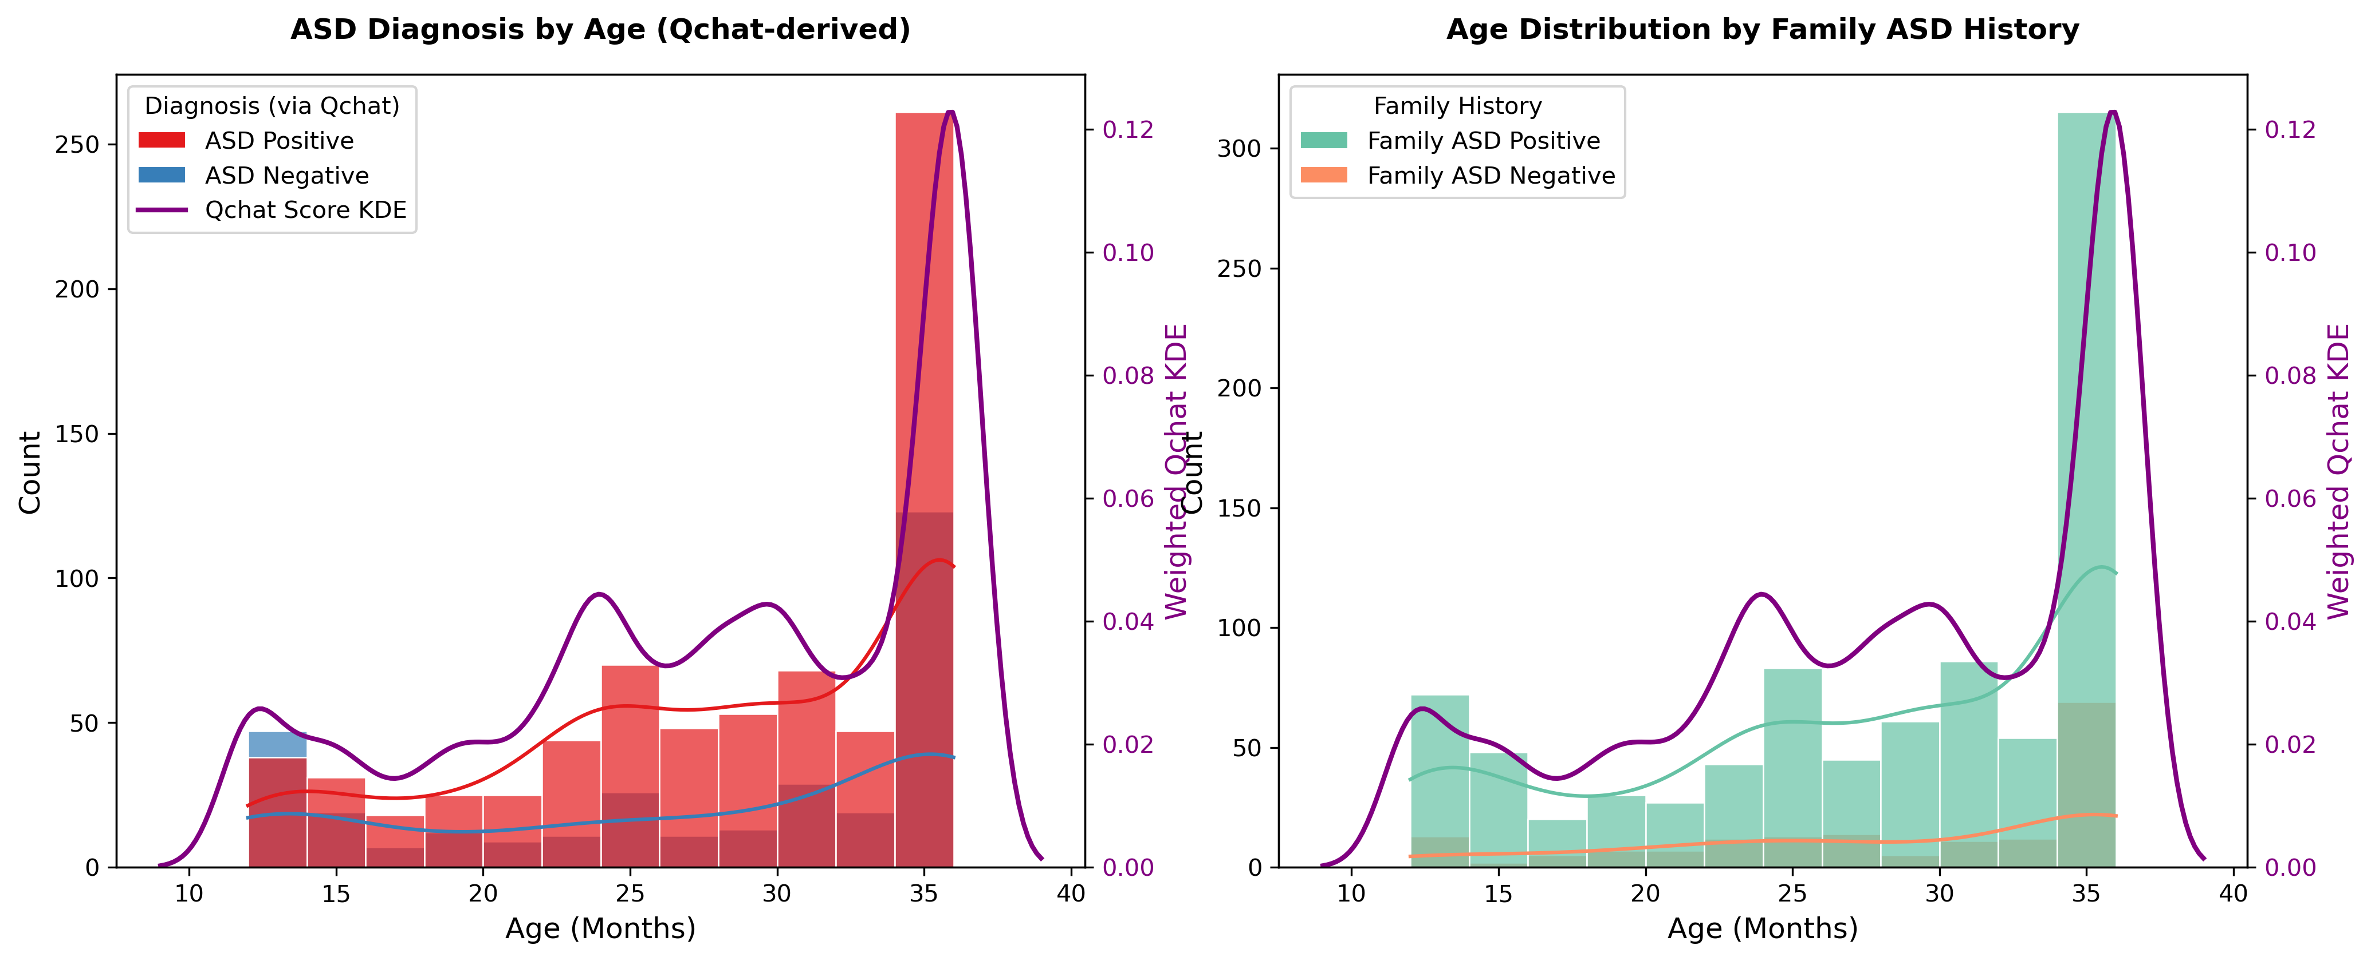
Autism Diagnosis by Age and Q-Chat Score

Slide 11
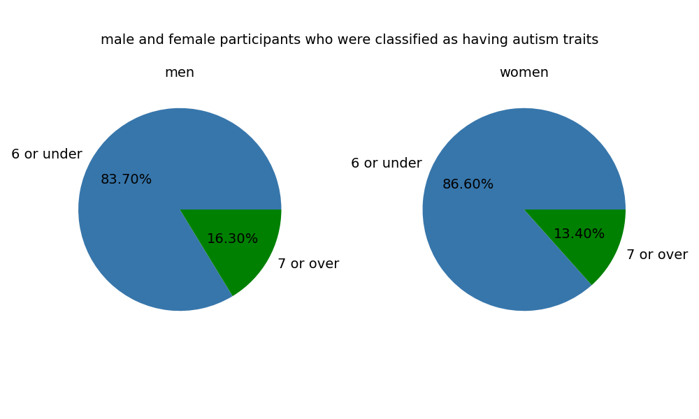
Autism traits Gender distribution
We wanted to compare the percentage of men with autism traits to the percentage of women with autism traits. To do this, we used pie charts because they're well-suited for visualizing percentage comparisons. We found that male participants have slightly higher rates of autism traits than women. This differs from rates of male:female autism diagnosis, which is around 3:1. Maybe there was selection bias.

Slide 12
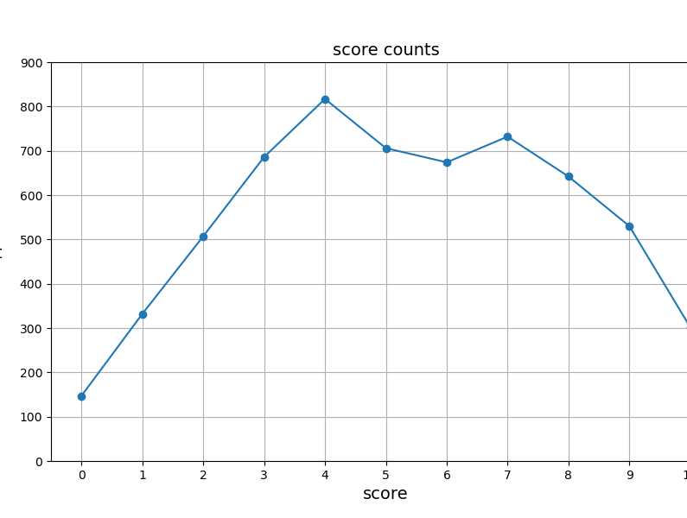
Autism score distribution
We used a line graph to visualize the prevalence of each of the eleven possible scores. More participants scored somewhere between 4 to 7. This could indicate that it's more common to be moderately autistic than it is to be highly autistic or slightly autistic.

Slide 13
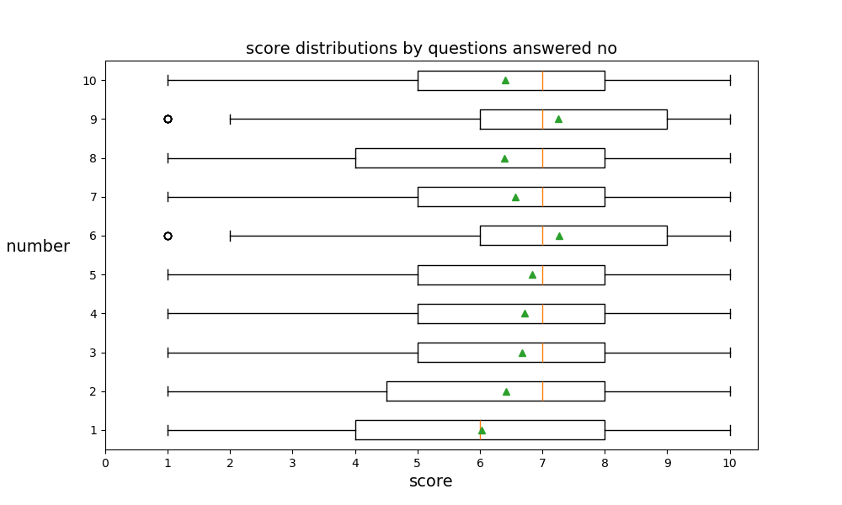
Score distribution by "no" answers
We used box plots to examine the correlation between points being scored on specific questions vs total points scored. Questions 9 ("Does your child use simple gestures? (e.g. wave goodbye)") and 6 ("Does your child follow where you’re looking?") are correlated with slightly higher scores than the other questions.

Slide 14
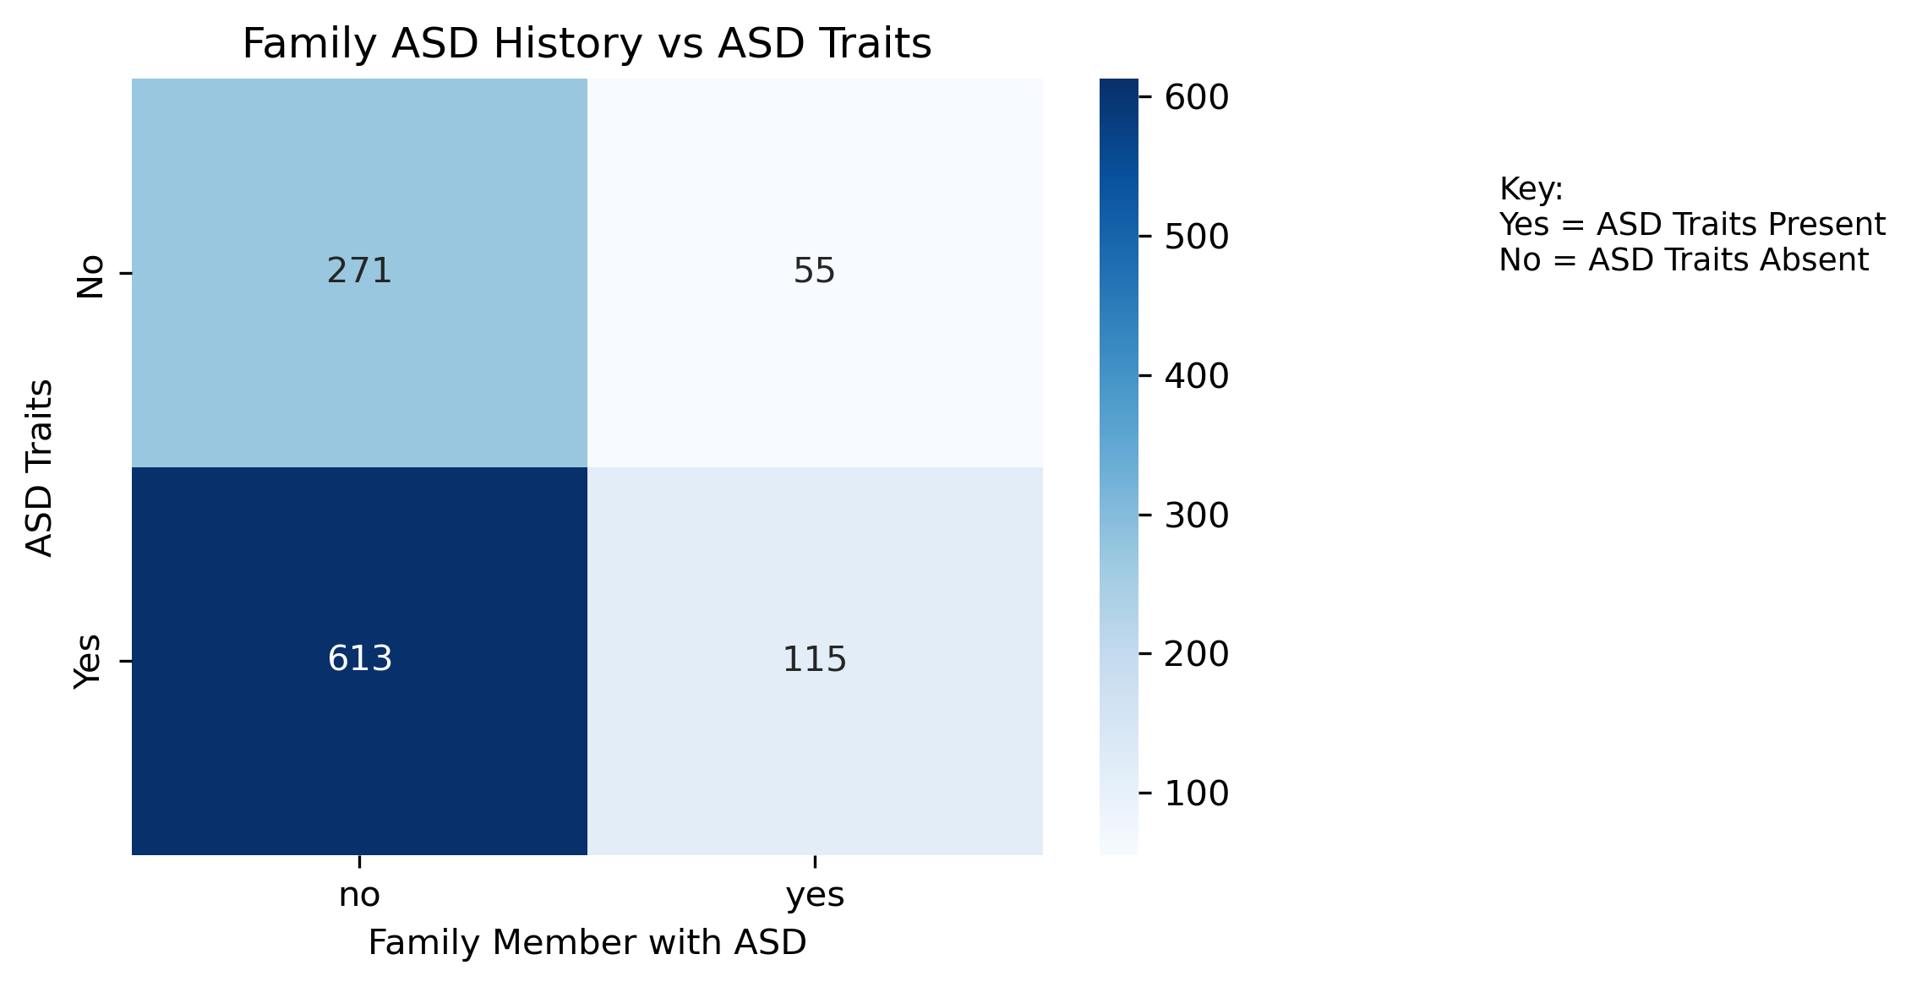
Family ASD History vs ASD Traits
Majority of ASD-positive toddlers had no family history
Still, over 100 ASD cases had a reported family link
Family history could matter, but it is not a strong predictor alone
Notes:
We made this heatmap to explore whether having a family member with autism is linked to toddlers showing ASD traits.
What stood out was that most toddlers with ASD traits did not have a reported family history, but a good number still did.
So family history might be a contributing factor, but not the main one. This helped us see that autism traits can appear even without any family background, which is important when it comes to early screening.

Slide 15
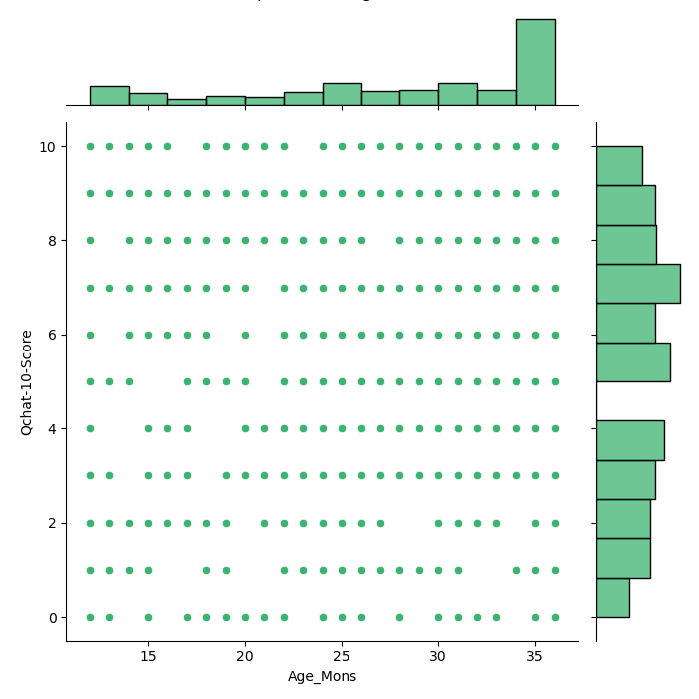
Q-Chat Score Distribution
Most ASD-positive toddlers had scores above the risk cutoff
This shows how scores are spread across the dataset
Helped us see how often high scores appeared in each group
Notes:
This joint plot helped us look at how Q-Chat scores are spread across the dataset. We noticed that most toddlers who had ASD traits had scores above the screening cutoff of three.
It also let us compare both groups and see that higher scores were more common in the ASD-positive group.
There wasn’t a strong pattern with age, but this view helped confirm that the score itself is important in identifying autism traits.

Slide 16
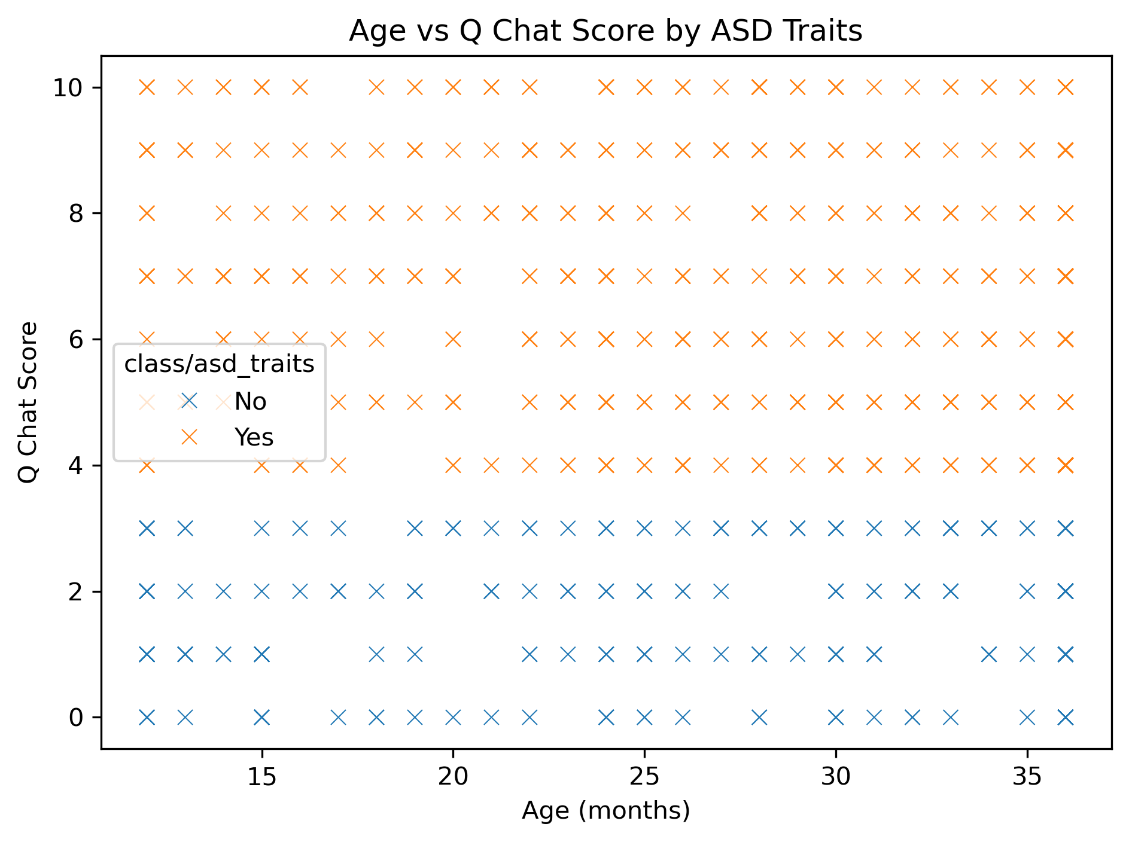
Age vs Q-Chat Score by ASD Traits
ASD-positive toddlers mostly had higher Q-Chat scores
Clear pattern between score and diagnosis
Plot helped us spot that separation visually
Notes:
This scatter plot shows how Q-Chat scores relate to autism traits. Each point represents a toddler, and we noticed that most of the toddlers who had ASD traits scored higher. That pattern was really clear.
We were not focusing on age directly, but having it on the x-axis helped us notice how Q-Chat scores made the difference.
The plot helped confirm that the more “yes” answers a toddler gives on the screening, the more likely they are to be flagged for ASD traits.

Slide 17
Correlation Insights
Diagnosis Insights are found in PC1
Behavioral discernment in PC2/PC3
Verbal behaviors in PC2
Non-verbal behaviors I PC3

Slide 18
Conclusion
Key Insights
Autism traits were more prevalent among men.
Moderate autism scores were more common than low or high autism scores.
Not using simple gestures and not following a parent's gaze were correlated with slightly higher autism scores.

